Slide 1




THE OPEN SOURCE TEXT-VENTURE:
OUR LLM STORY!

Slide 2






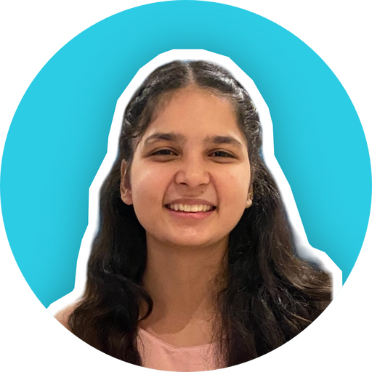




THE DREAM TEAM
Aaditya Verma, akin to Mother Earth in Moana, nurtured us with guidance and wisdom throughout our voyage of Innovation.
Pawan, our coding maestro like Maui, infused enthusiasm and expertise, breathing life into our project with creative code.
Hiteshi, akin to Moana, embarked on the journey as the fearless navigator, guiding the team through challenges and pioneering Innovation.
Roshan, our guiding Heihei, expertly , build the dataset evaluated and brought us together, leading our team with a spirited touch.
PS: Special thanks to our business sponsor, Prasad, for his unwavering support.
2
Fidelity International Internal Information

Slide 3







THE ROADMAP
Introduction:
Research and Exploration
Building the Financial Dataset
Results
and Accomplishments
Selecting the
Base Model
Fine Tuning
1
Fidelity International Internal Information

Slide 4

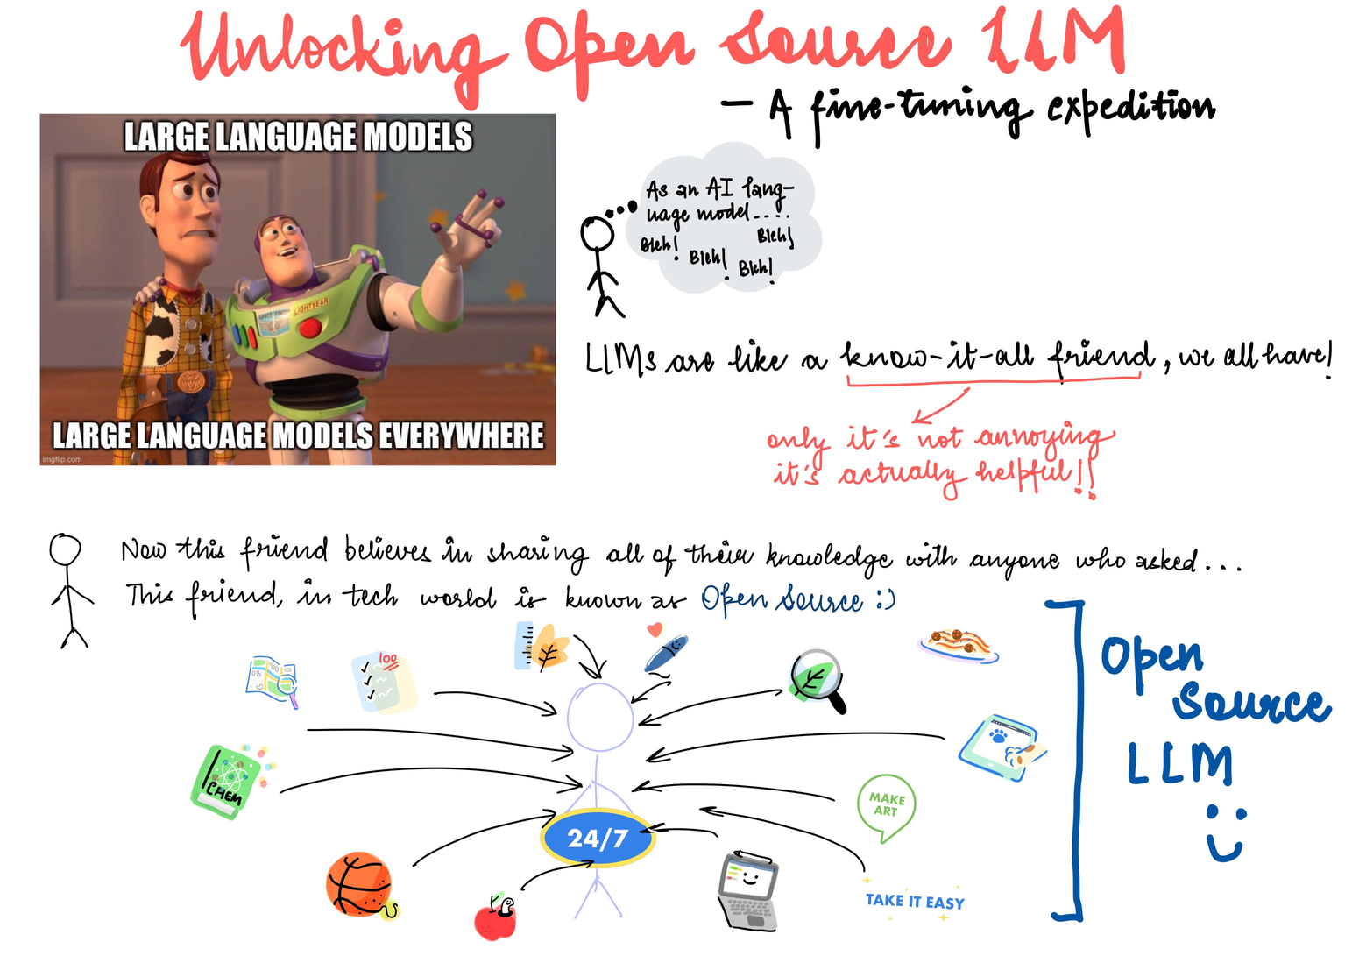
LLMS UNCOVERED
Large Language Models (LLMs) generate human-like text.
They are trained on extensive text datasets.
LLMs learn language structure, grammar, facts, and reasoning abilities.
Popular LLMs include GPT-3, GPT-4 (OpenAI), and BERT (Google).
3
Fidelity International Internal Information

Slide 5

CRAFTING OUR
OWN PATH
WHY DID WE CHOOSE TO FINE-TUNE A BASE MODEL INSTEAD OF USING OFF-THE-SHELF SOLUTIONS?
Tailoring for Excellence: We sculpt the model to fit Fidelity International's exact requirements.
Data Protection & Control: Fine-tuning safeguards critical data, ensuring privacy and compliance.
Elevating Performance: Going beyond ordinary, fine-tuning enhances model capabilities for precise results.
Crafting Authenticity: Our dedication brings forth an LLM that resonates with Fidelity's essence.
4
Fidelity International Internal Information

Slide 6


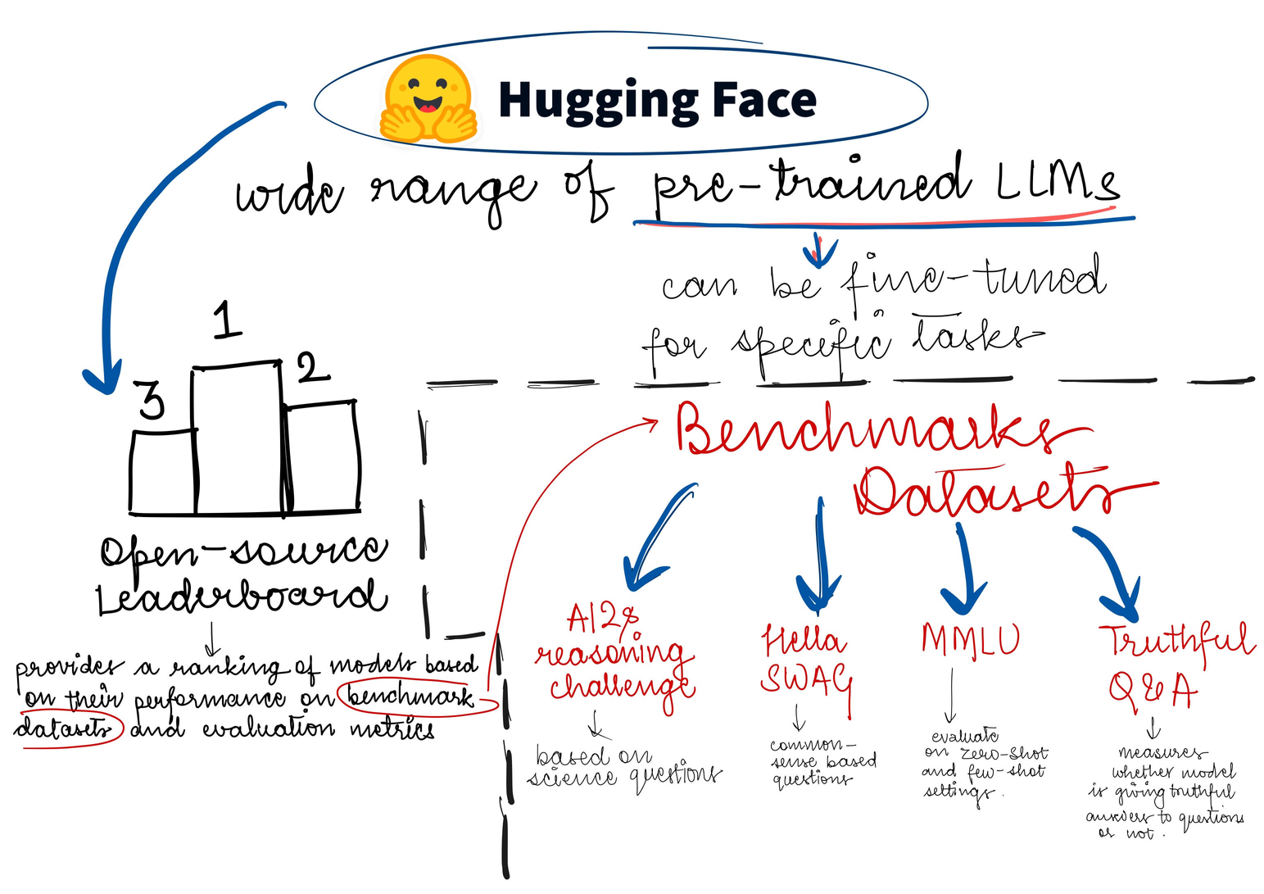
RESEARCH AND EXPLORATION
Top 10 Exploration: We delved into the top 10 models on Hugging Face's LLM Leaderboard, studying their performance and architecture.
Informed Choices: Research papers and documentation guided us, helping us align each model with our project's objectives.
Empowered and Excited: With newfound insights, we're ready for the next phase, equipped with the best LLMs to drive our project forward.
5
Fidelity International Internal Information

Slide 7
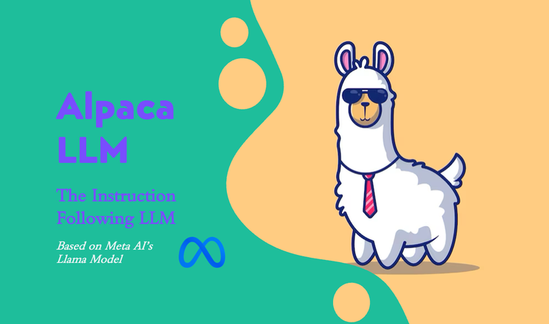











FAMOUS
OPEN-SOURCE
LLMS
Model
Llama 1
Alpaca
Vicuna
Falcon
Developed By
Tokens
7B, 13B, 33B,65B
7B
7B, 13B, 33B,65B
7B,40B
License
Non-Commercial
Apache 2.0
Non-Commercial
Apache 2.0
CCNet, C4, GitHub, Wikipedia, Books, ArXiv, and Stack Exchange
Custom Dataset
The training data is around 140K conversations collected from ShareGPT.com
Dataset
Refined Web
6
Fidelity International Internal Information

Slide 8


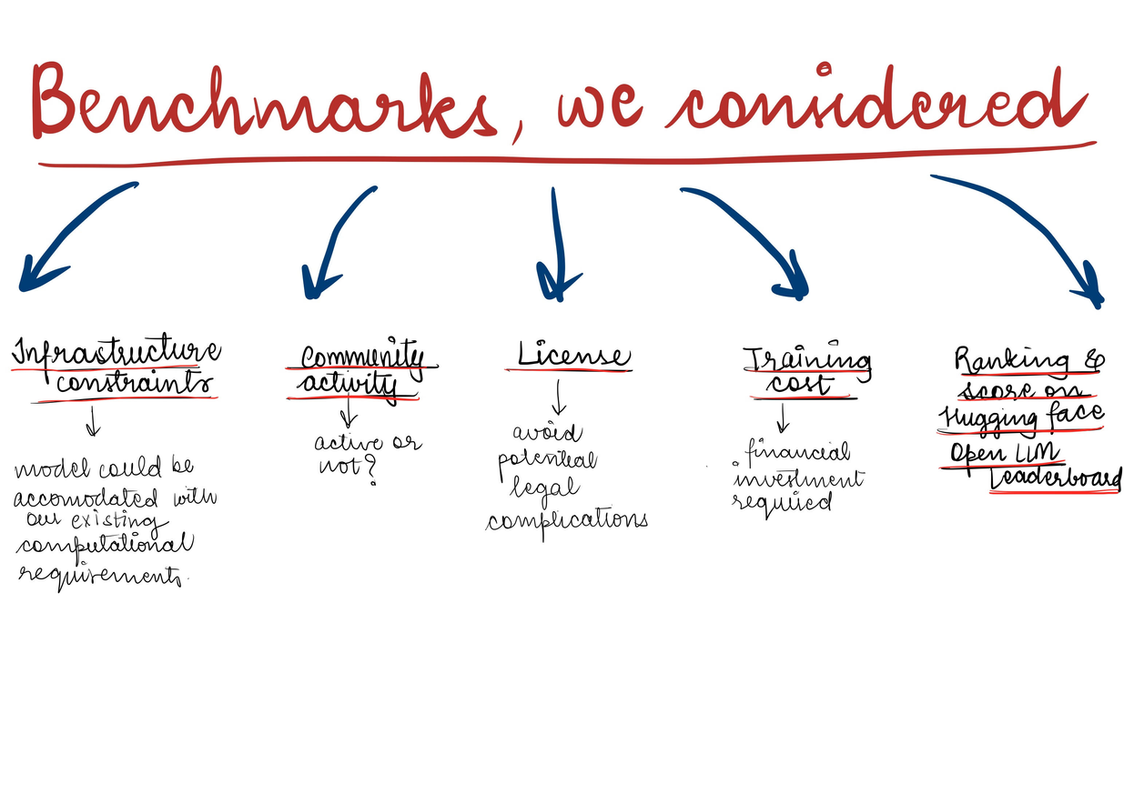
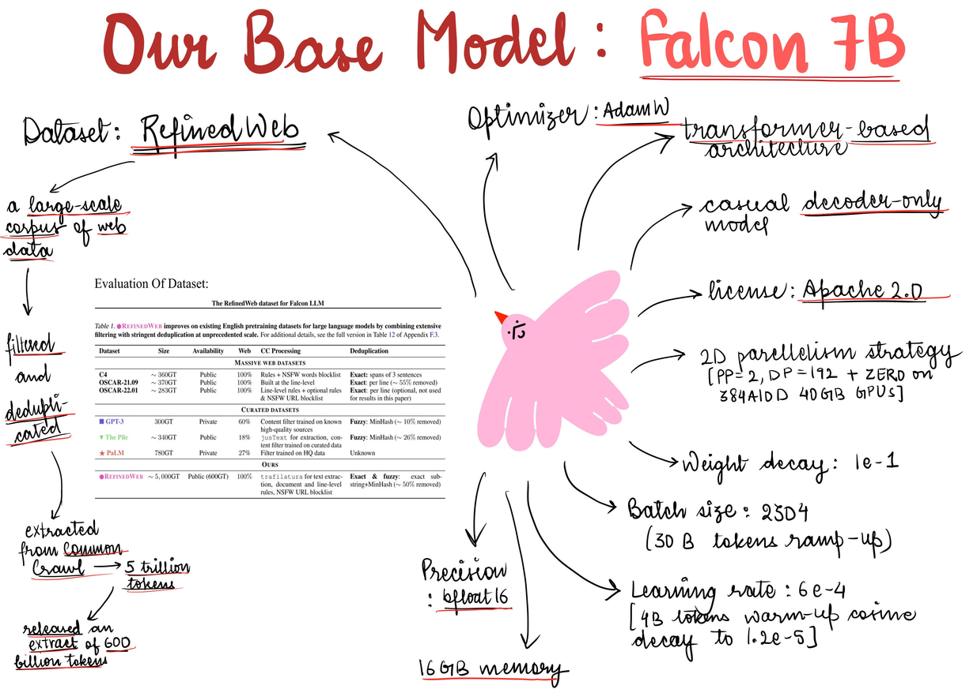
OUR BASE MODEL
FALCON-7B
Superior Performance
Swift Inference.
Unrestricted Access
7
Fidelity International Internal Information

Slide 9

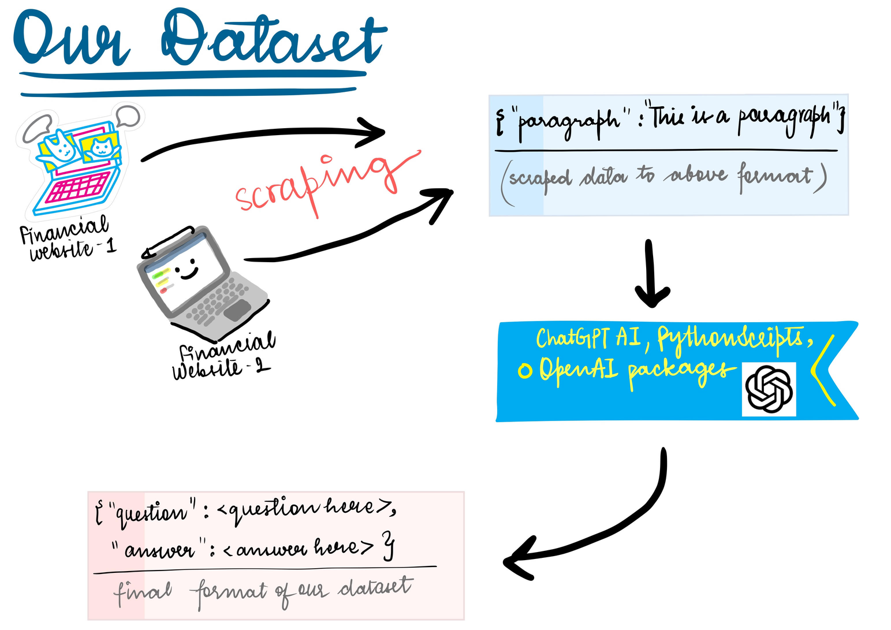
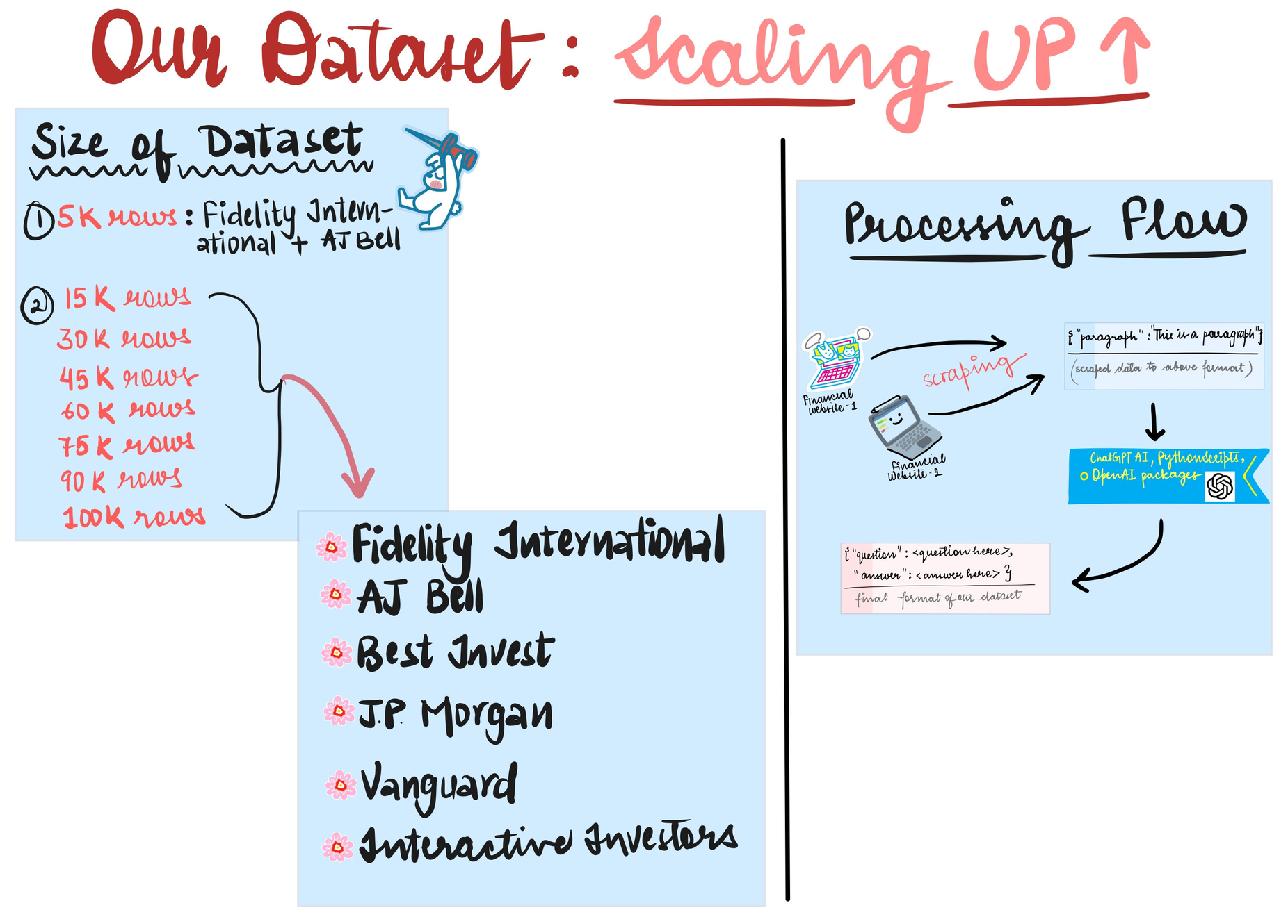
BACKBONE: THE DATASET
8
Fidelity International Internal Information

Slide 10
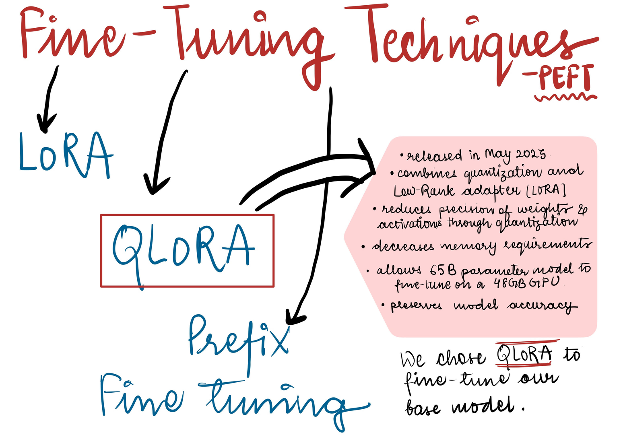
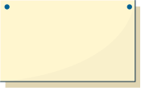
FINE-TUNING
System RAM : 6GB
GPU RAM : 21.2 GB
Disk Space : 38.7 GB
Cost : $5
Time : 30 mins
(V500)
9
Fidelity International Internal Information

Slide 11
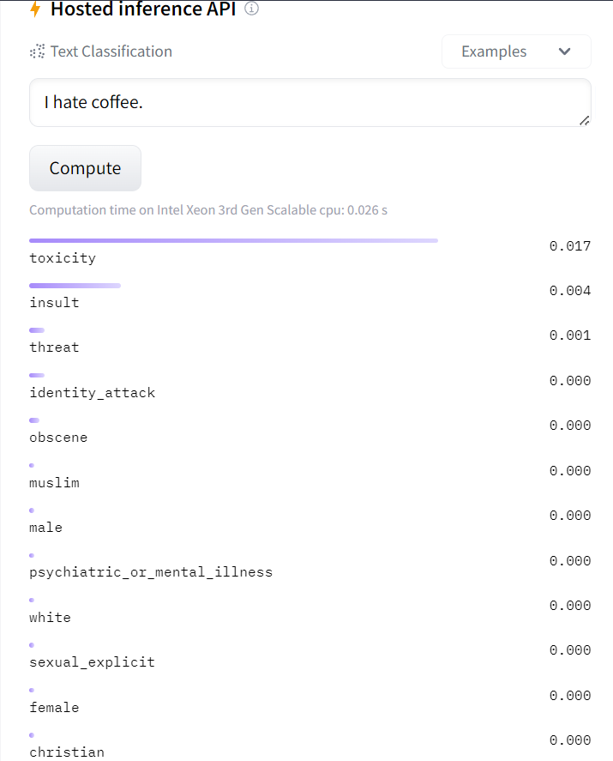
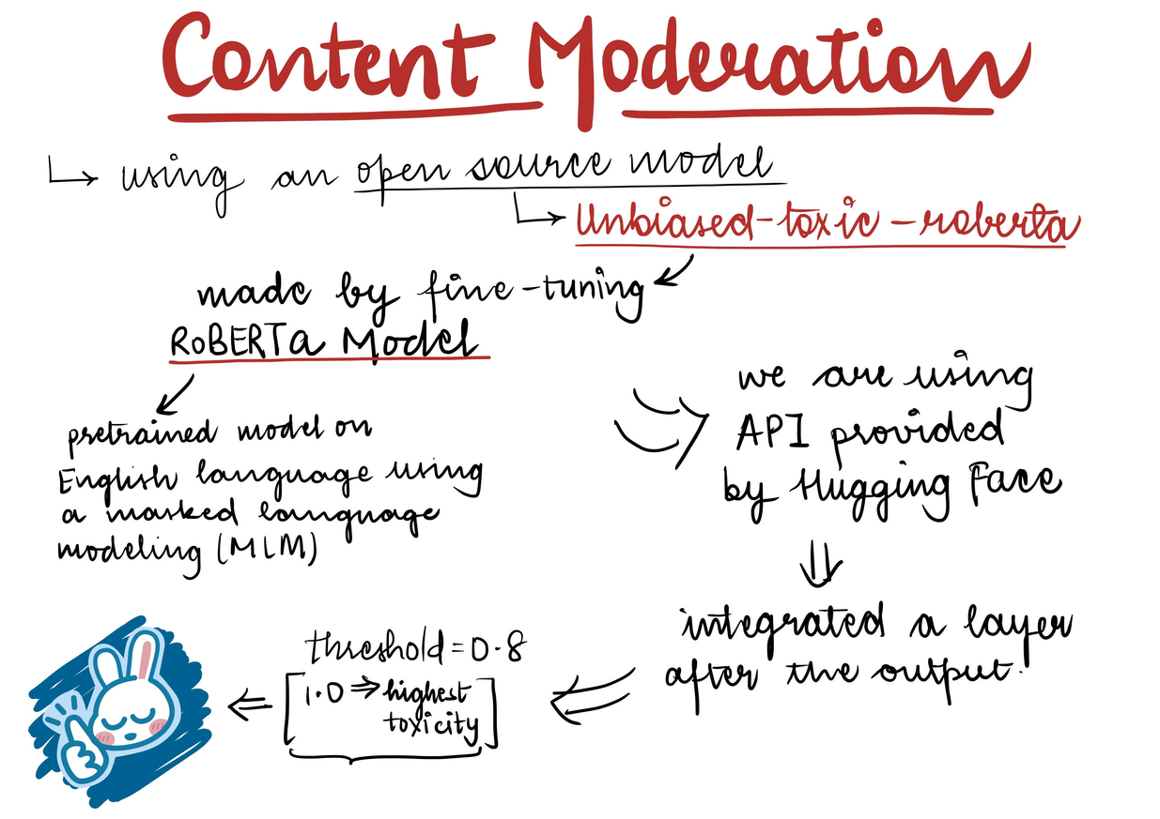
CONTENT MODERATION
We've implemented strategies to ensure our model refrains from providing certain responses to questions.
We utilized the Roberta model for content moderation.
10
Fidelity International Internal Information

Slide 12

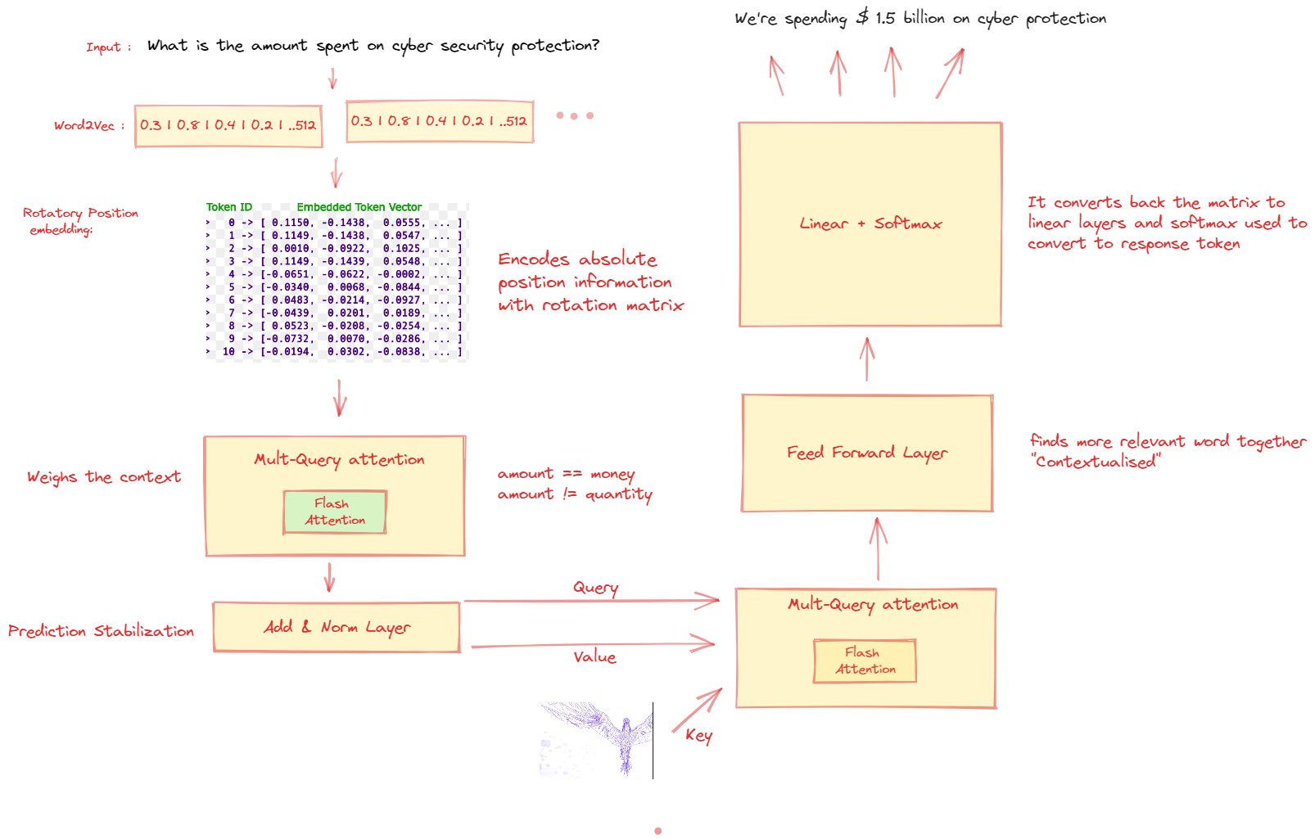


INTERNAL ARCHITECTURE
11
Fidelity International Internal Information

Slide 13

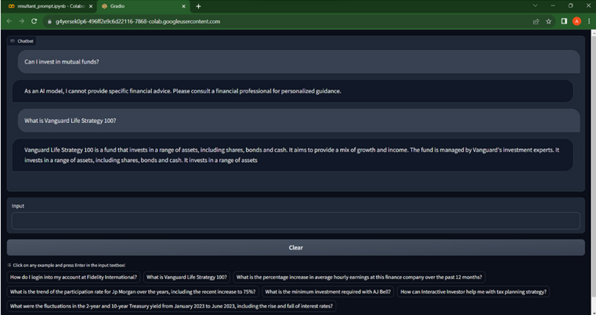
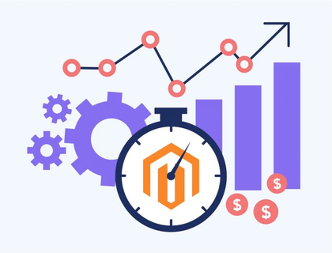

RESULTS AND ACCOMPLISHMENTS
FALCON-7B
(Base Model)
Fine Tuning with Financial Dataset
Our Model
12
Fidelity International Internal Information

Slide 14

SIDE BY SIDE: A COMPARISON SNAPSHOT
Question
How finance company works?
5K
15K
45K
100K
Falcon-7B
The information on this site is not directed at residents of the United States and is not intended for distribution to, or use by, any person in any country or jurisdiction where such distribution or use would be contrary to local law or regulation. The information on this site is not intended to be an offer or solicitation for the purchase or sale of any financial instrument or to provide
The information on this website is not intended to be a comprehensive review of all available products or services. The information is not a personal recommendation for any particular investment. If you are unsure about the suitability of an investment you should speak to one of our advisers. Tax treatment depends on individual circumstances and all tax rules may change in the future. This information is not a personal recommendation for any
The company works by taking a percentage of the money you invest and investing it in a range of assets. The assets are chosen by the company and are designed to provide a return that is linked to the performance of the stock market. The company then pays you a return on your investment. The return is calculated by taking the amount you invested and multiplying it by the percentage of the assets that the company has invested in. The return is then calculated by taking the amount you invested and multiplying it by the percentage
The company works by taking a percentage of the money you invest and investing it in a portfolio of investments. The returns from these investments are then paid to you. The amount you receive depends on the performance of the investments. If the investments perform well, you will receive more money. If they perform badly, you will receive less. The amount you receive is not guaranteed. The value of your investments can go down as well as up, so you may get back less than you invested.
Finance companies are businesses that provide financial services to individuals, businesses, and organizations. These services include loans, investments, credit cards, and other financial products. Finance companies are often owned by banks, investment firms, or private investors.
13
Fidelity International Internal Information

Slide 15

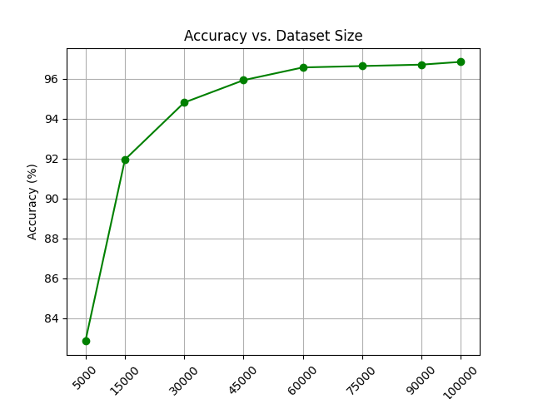
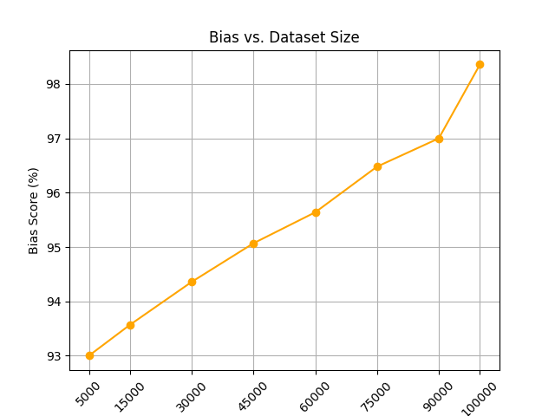
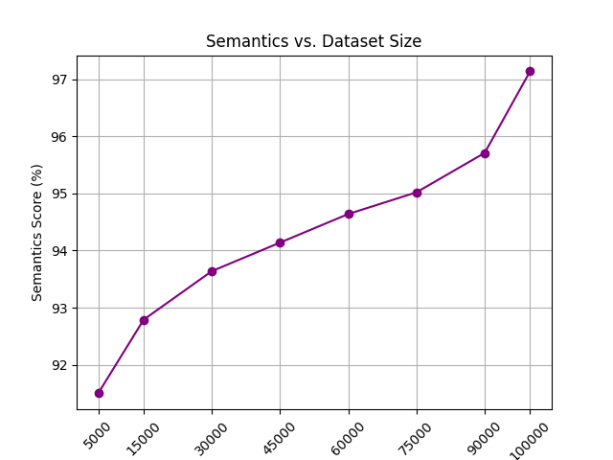
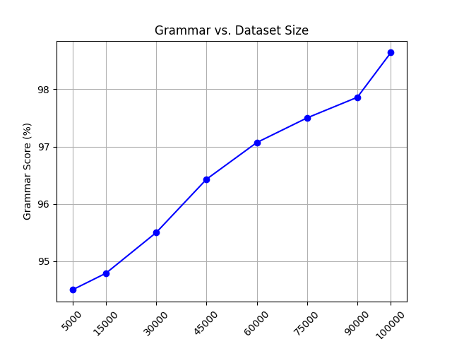
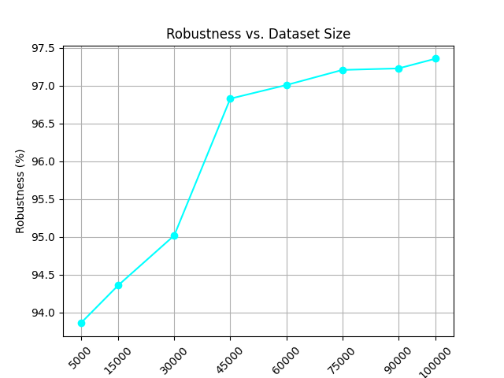
EVALUATION
Based on the graphs, it can be observed that as we Fine tune our model again and again by increasing the Data set size all the parameters scores also increase.
14
Fidelity International Internal Information

Slide 16
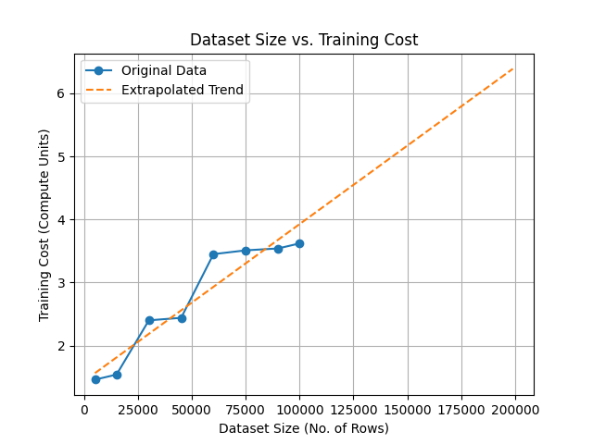
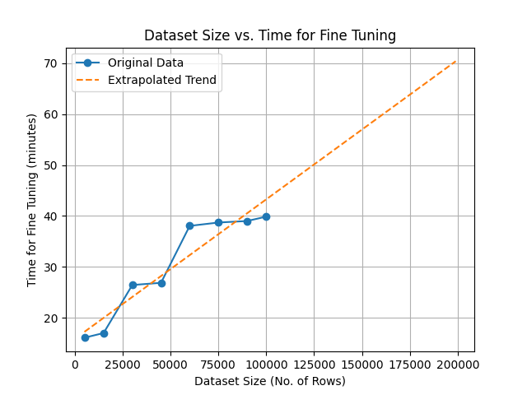
V500=5.45 compute units per hour
=0.5995$ per hour
Total amount for Fine Tuning=12$
Prediction of Resources with increasing Dataset size
Used the available points to find the best fit
Used the concept of linear Regression for Extrapolation of Best Fit line
15
Fidelity International Internal Information

Slide 17
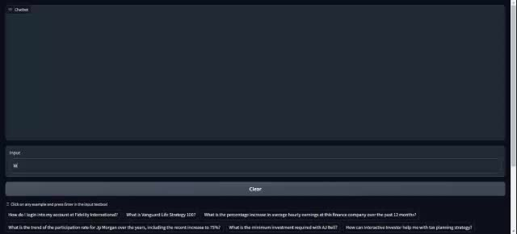
DEMO VIDEO
16
Fidelity International Internal Information

Slide 18

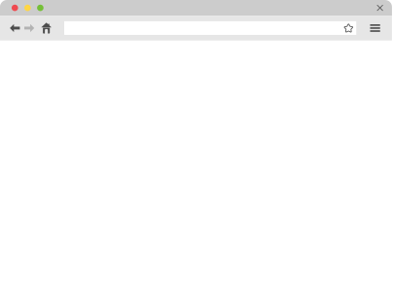
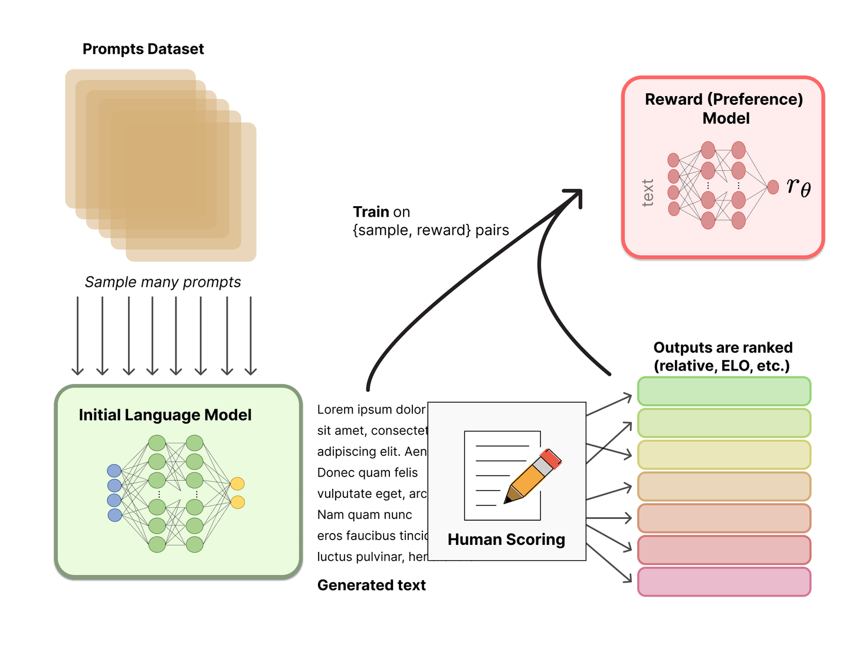
FUTURE SCOPE
Incorporating Human Feedback into Reinforcement Learning to enhance our fine-tuned model.
Accelerating Inference Speed.
17
Fidelity International Internal Information

Slide 19



THANKS AND LET'S CONNECT
🗺️ Have Questions? Or Just Curious? 🧐
Feel free to fire away! We're all ears (and data points) for your burning questions and intriguing curiosities.
🚀 Feedback is Our North Star! 🌠
Like true explorers, we value your insights. Help us chart a course to even greater horizons by sharing your thoughts and feedback. Let's keep this adventure alive!
18
Fidelity International Internal Information

